Slide 1
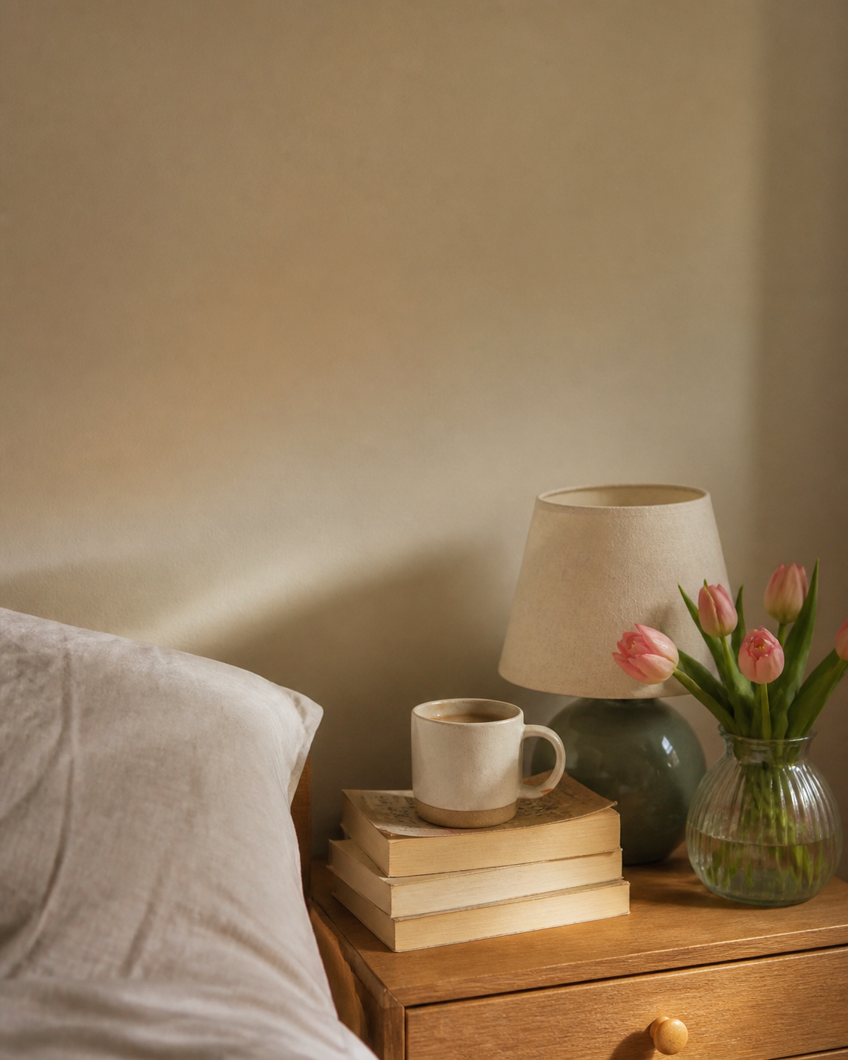
NIGHTSTAND EDIT · 01
✿
♡
my nightstand
right now
✦
✿
the little corner that makes staying in feel extra special
01 · lately

Slide 2
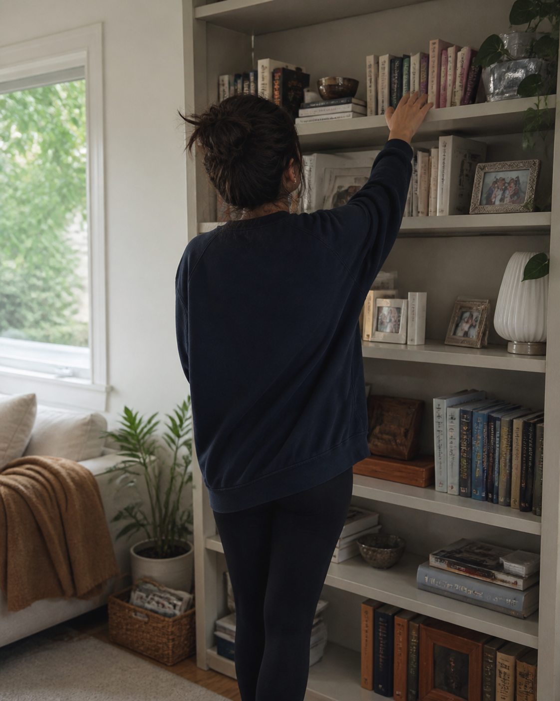
SLOW MORNING CLUB · 02
✿
♡
coffee and
a few pages
✦
✿
one chapter before anything else gets a say
02 · lately

Slide 3
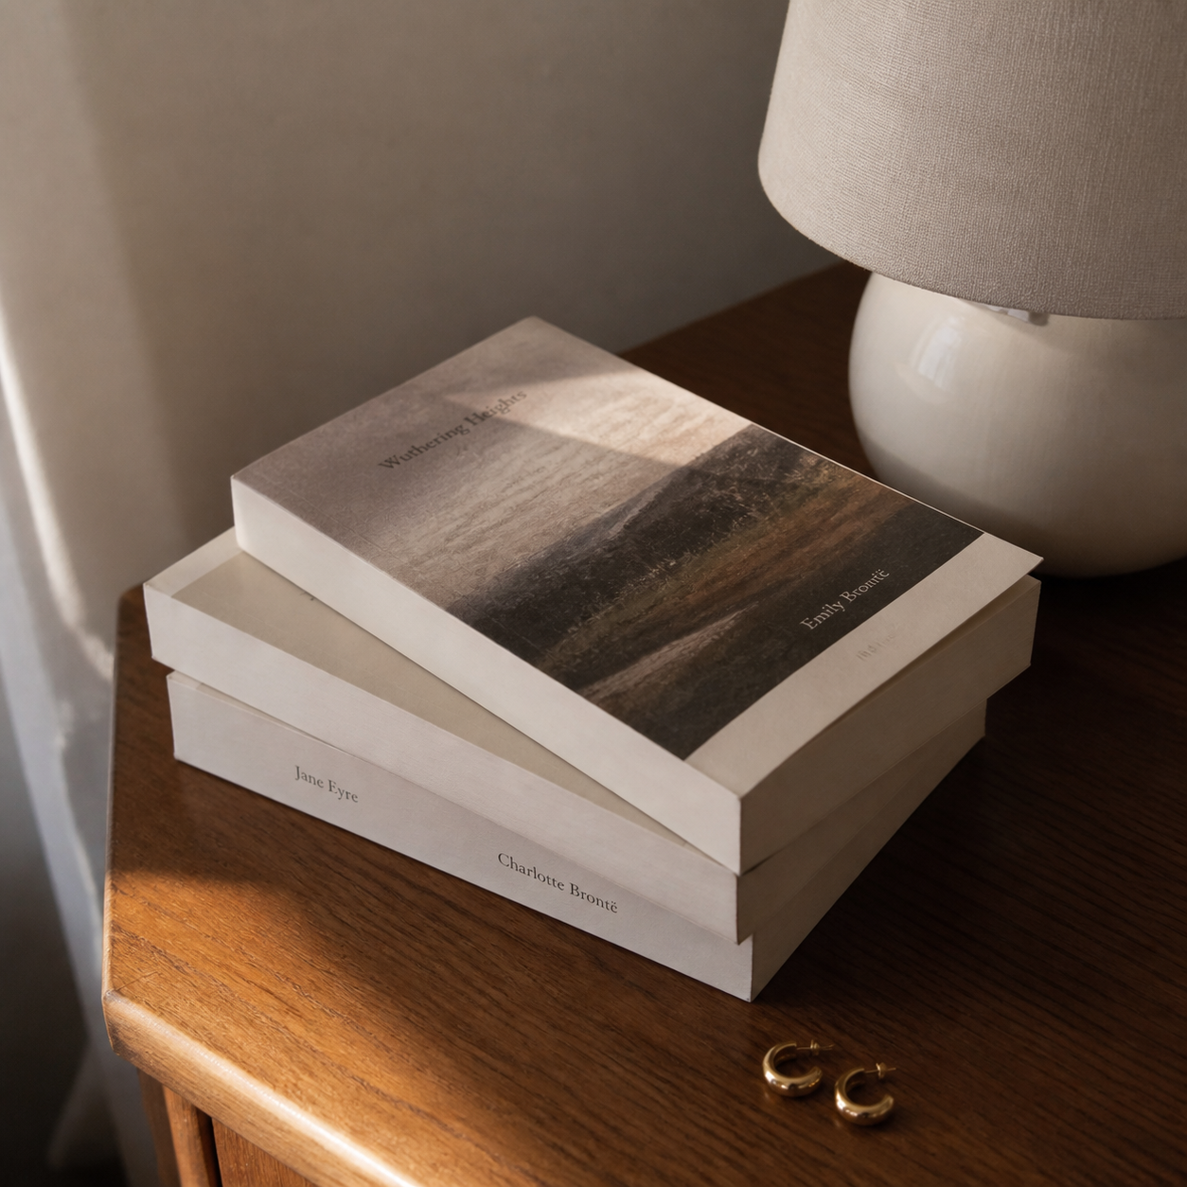

CURRENTLY · 03
✿
♡
stacked by
the bed
one chapter at a time
✦
✿
little things i love
03 · lately

Slide 4
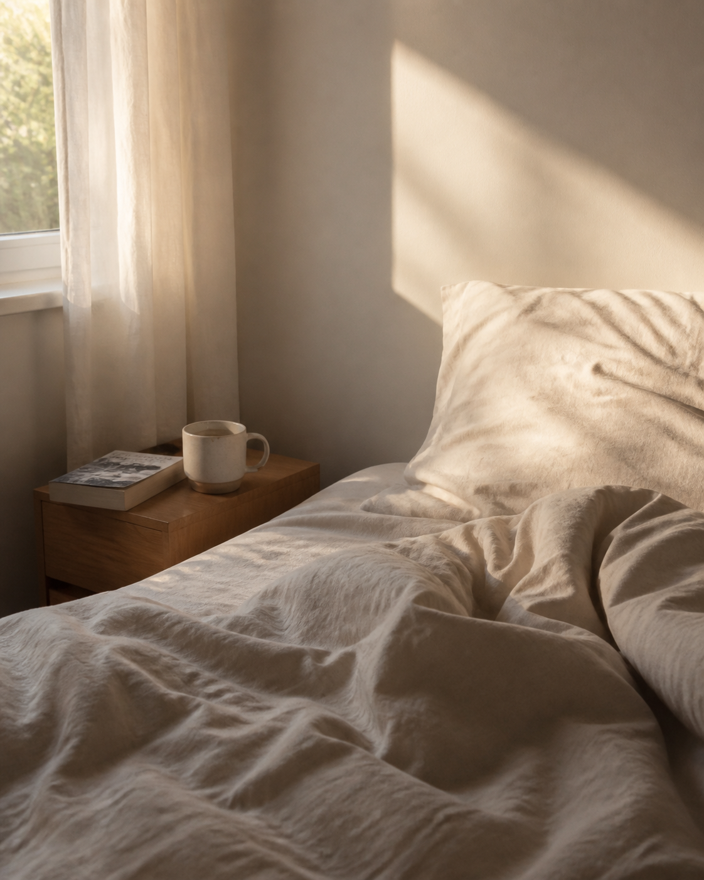
NIGHTSTAND FAVES · 04
✿
♡
homebody
essentials
♡
slow pages
✦
♡
a warm drink
✿
♡
lights off early
04 · lately

